Slide 1


Andela x OpenAI Codex
Accelerator

Slide 2

Overview – OpenAI Codex Hackathon
Andela AI Academy is a strategic initiative designed to position Andela engineers at the forefront of emerging technologies. Its strong focus is on AI-assisted development, agentic software practices, and future-facing engineering capabilities.
Key Focus Areas:
AI-powered coding and agentic developer tools
Agentic software development methodologies
Scalable, real-world learning experiences
Hackathon-ready project delivery and global readiness
The Accelerator is a two-week intensive program designed to help learners build practical proficiency in OpenAI Codex for real-world software development workflows. It combines structured self-paced learning with live expert workshops, guided practice, and project ideation to ensure learners move beyond passive course consumption into real application.
Over the course of the program, learners will:
Understand OpenAI Codex and use it across CLI, IDE, desktop, and cloud workflows
Apply prompt and context engineering techniques for reliable coding outcomes
Use Codex for code generation, debugging, refactoring, documentation, planning, and review
Understand structured and agentic workflows: AGENTS.md, MCPs, skills, and automations
Build a hackathon-ready capstone project with Codex

Slide 3

Program Delivery
01
Talent Onboarding / Launch
02
Learning Phase
03
Expert Sessions / Workshops
Hold Onboarding session to walk participants through program details.
Program timeline:
  Learning Phase – 1 week
  Project Phase – 1 week
Distribute Learning resources
  OpenAI resources
  Access to Codex
  Ensure sign-up to ChatGPT free tier
Weekly interactive sessions designed for active engagement and practical application:
Hands-on practice on building real-world workflows.
Direct access to domain experts for guidance and mentorship.
04
Program Management
05
Projects
06
Post-Program Feedback
Dedicated learning channel created to manage the program, foster peer connections, and share feedback.
Ensure experts arrive on time and each program milestone is successfully met by experts and learners.
Practical project execution phase:
Build end-to-end workflows project applying concepts learned during sessions.
Capstone submission and evaluation.
Gather comprehensive feedback from program participants.
Collect qualitative feedback and recommendations from experts to continuously improve future cohorts.

Slide 4
Learning Phase

Slide 5
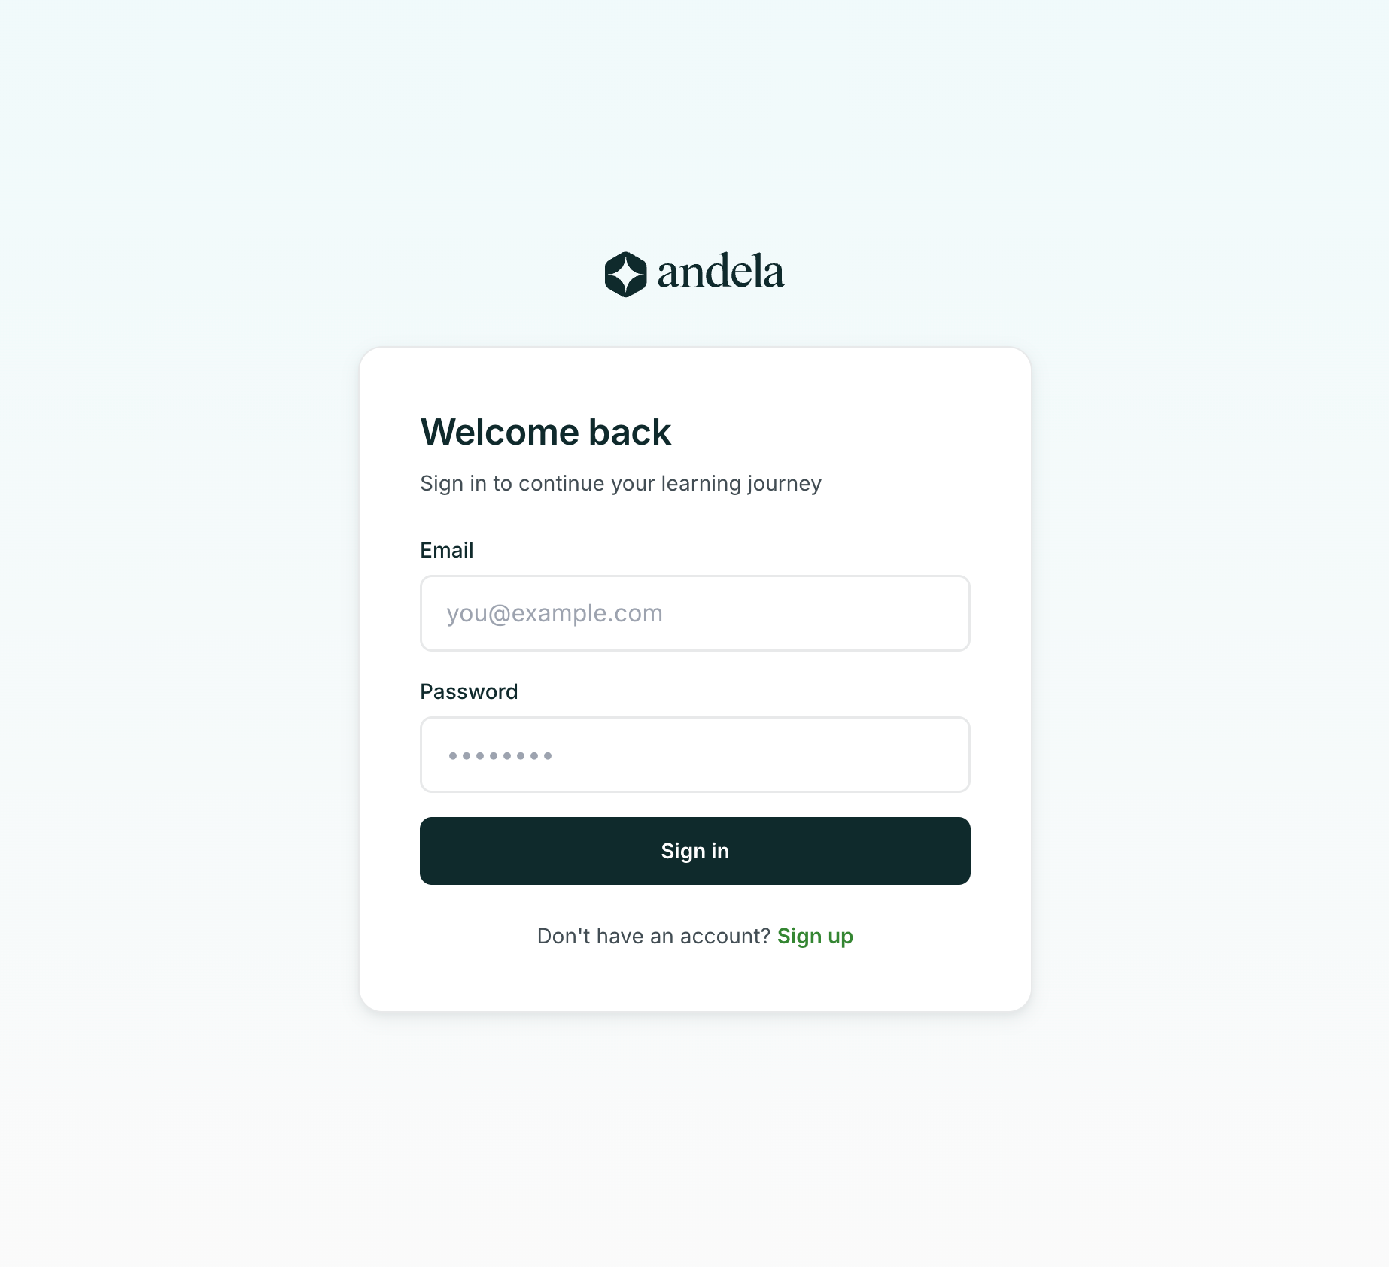

Program LMS
Dedicated portal to complete learning resources
01
Sign Up
Complete your sign up using the portal link to gain access to all program modules and learning materials.
02
Pre-Program Baseline Assessment
Upon sign up, complete the baseline assessment before starting your learning. This assessment establishes a pre-program skill baseline only and does not pass or fail you.
03
Modules
Work through and complete all learning modules to unlock access to the capstone project theme.
Hire anywhere. Deliver everywhere.

Slide 6
Learning Resources
Explore the Codex curriculum and Capstone project requirements
01
OAI Resources
Codex Learning Path (Builders Club)
Codex 101
Introduction to Codex & agentic coding
Codex 102
Prompting, planning & spec-driven execution
Codex 103
Advanced workflows & hackathon readiness
AGENTS.md, MCPs, and reusable skills
Configurations, approvals, and sandboxing
Codex Agentic Workflows
End-to-end multi-agent orchestration and patterns
02
Capstone Project Phase
Project Track Options
AI Codebase Analyst & Refactor Agent
Automated code inspection, refactoring recommendations, and automated code review routines.
Codebase Onboarding Agent
Intelligent agent to assist new developers in navigating and understanding complex repositories.
African Stack Integrator
Targeted integrations connecting localized tools and tech ecosystems seamlessly.
Submission Deadline: 11th of November

Slide 7
Project Build | Hackathon

Slide 8
Andela x OpenAI Hack-a-thon
The top projects from this cohort will be showcased and pitched live.
What your capstone must demonstrate
Each project should show the panel four things:
Depth of Codex Integration: Codex is visible across the workflow (planning, building, reviewing, documenting), not bolted on at the end. Use of AGENTS.md, plan mode, MCPs, or reusable skills strengthens this.
Real-world Impact: The project solves a concrete problem tied to an impact theme (health, climate, finance, agriculture, education). The "who benefits and how" is specific, not abstract.
Reusability & Adoption Potential: Someone other than you could pick this up and run with it. Clean structure, documentation, and a defensible path from prototype to production.
Demo & Pitch Quality: A sharp 3–5 minute walkthrough: problem, solution, Codex's role, and what you'd do with another month.
Key dates
Week 1 — Submit your project idea for review/feedback
Week 2 — Project build kicks off
Final week — Scoring begins; judges review submissions against the four criteria above
What's on the line
Cash prizes for the top-scoring projects
A live pitch slot at a physical event in Cape Town
Visibility across the Andela engineering community via #builtwithcodex

Slide 9
Dedicated learning channel
Join the dedicated private channel for this program using the link you received in the welcome email.
Sign up:
Ensure you follow the instructions in the welcome email to join the channel.
Resources and updates
Program updates will be shared via this channel.
Collaborate with colleagues in the chat channel
Share tips, blockers with colleagues in the channel.
Modules
Complete all modules before you have access to the capstone project theme.

Slide 10
Expectations
Your Expectation
Issue learning resources
Access to AI Tools
Provide additional resources (where required)
Manage community space
Weekly check-ins
Our Expectations
Complete Learning
Engage in the community
Group learning
Ask, ask, communicate!
Join workshops

Slide 11
Q&A

Slide 12


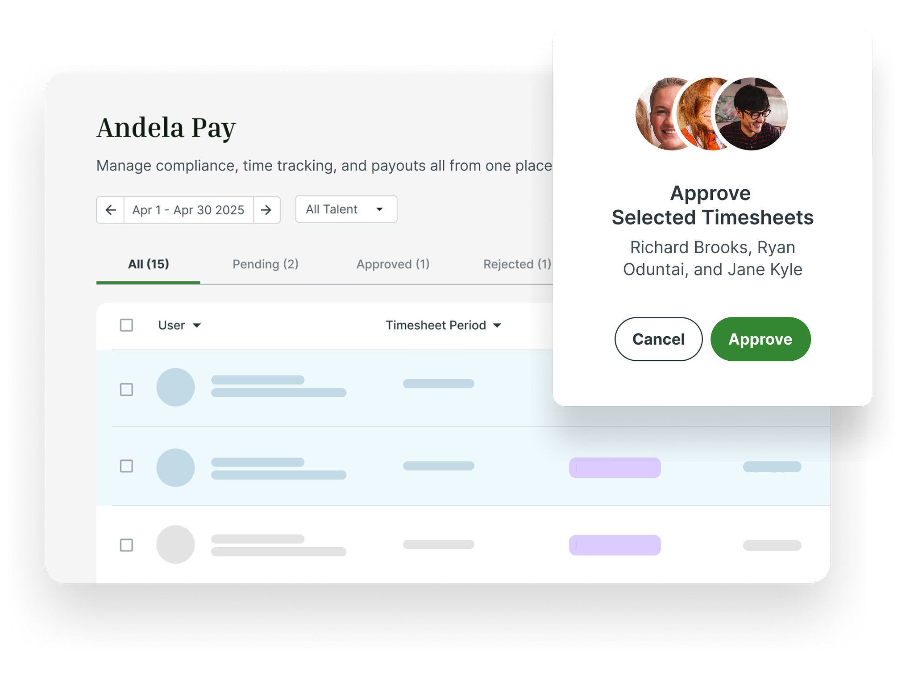


Thank you.

